Slide 1

Summer Internship on Serverless website using Amazon Lambda By GAJANGI MAHESHWARI 1608-19-735-031 Department of Electronics and Communication Engineering MATRUSRI ENGINEERING COLLEGE (Sponsored by Matrusri Education socitey, Estd1980) (Approved by AICTE, Affiliated to Osmania University) #16-1-486,Saidabad, Hyderabad, Telangana-500 059 www.matrusri.edu.in 2022-23

Slide 2
Contents
About the organization
Introduction
Project Details
Implementation
Results
Future scope
Conclusion

Slide 3

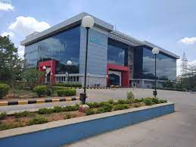
About the Organization
NSIC, established in 1955, is an ISO 9001 certified company.
Operates through 9 zonal Offices, 33 Branch Offices, 14 Sub Offices, 10 NSIC Business Development Extension Offices, 5 Technical services Centres, 3 Extension Centres and 2 Software Technology Parks supported by a team of over 500 professionals spread across the country.
Provides integrated support services such as marketing, Technology, Finance and other services.

Slide 4
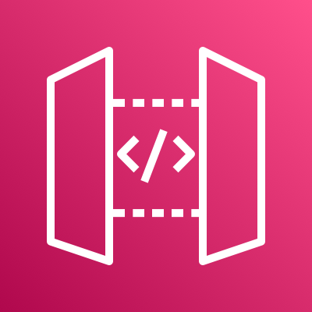


Introduction
Cloud Computing: It is delivery of computing services—including servers, storage, databases, networking, software, analytics, and intelligence—over the Internet (“the cloud”)
Management services(IAM)
Amazon VPC and features
Lambda Function
Amazon Elastic Cloud Compute(EC2)
Amazon RDS
API Gate way
Amazon connect
Amazon EC2

Slide 5
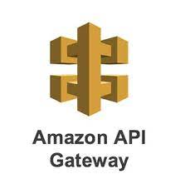

Serverless Web Application using AWS Lambda
A serverless architecture is a way to build and run applications and services without having to manage infrastructure.
In this project, these are the Amazon services used to create serverless static website
1. Amazon S3 bucket
2. API gateway
3. Amazon Lambda
4. Amazon DynamoDB

Slide 6
Amazon API Gateway
API Gateway is a fully managed service that makes it easy for developers to create, publish, maintain, monitor, and secure APIs at any scale.

Slide 7
Amazon S3 Bucket
Amazon S3 is an object storage service that stores data as objects within buckets.
An object is a file and any metadata that describes the file
S3 Bucket

Slide 8

AWS Lambda
It is a serverless, event-driven compute service that lets you run code for virtually any type of application or backend service without provisioning or managing servers.
Amazon Lambda

Slide 9
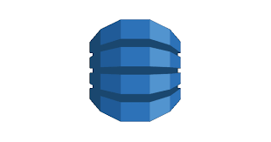
Amazon DynamoDB
Amazon DynamoDB is a fully managed, serverless, key-value NoSQL database designed to run high-performance applications at any scale.
DynamoDB

Slide 10
Implementation
User
Lambda
S3 bucket
API gateway
DynamoDB

Slide 11
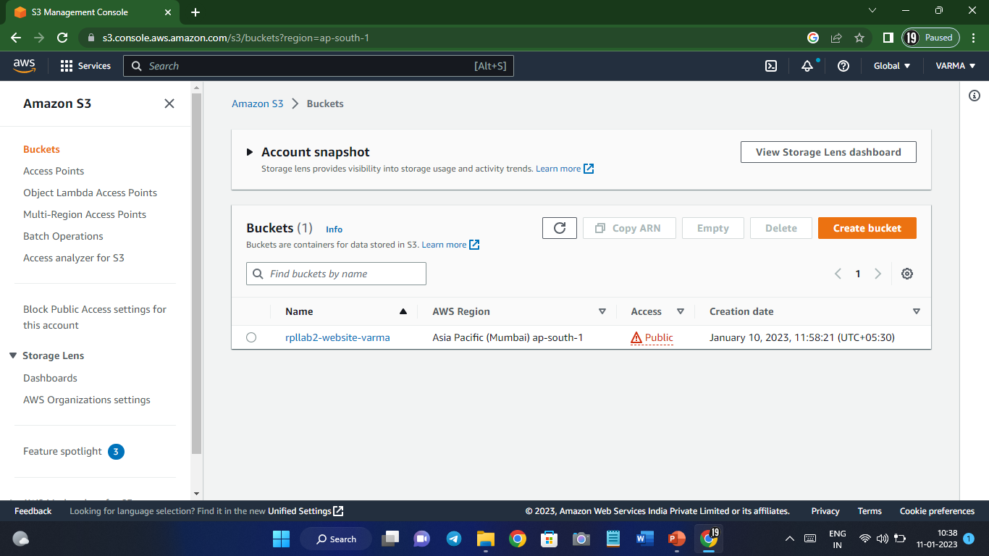
Creating s3 Bucket

Slide 12
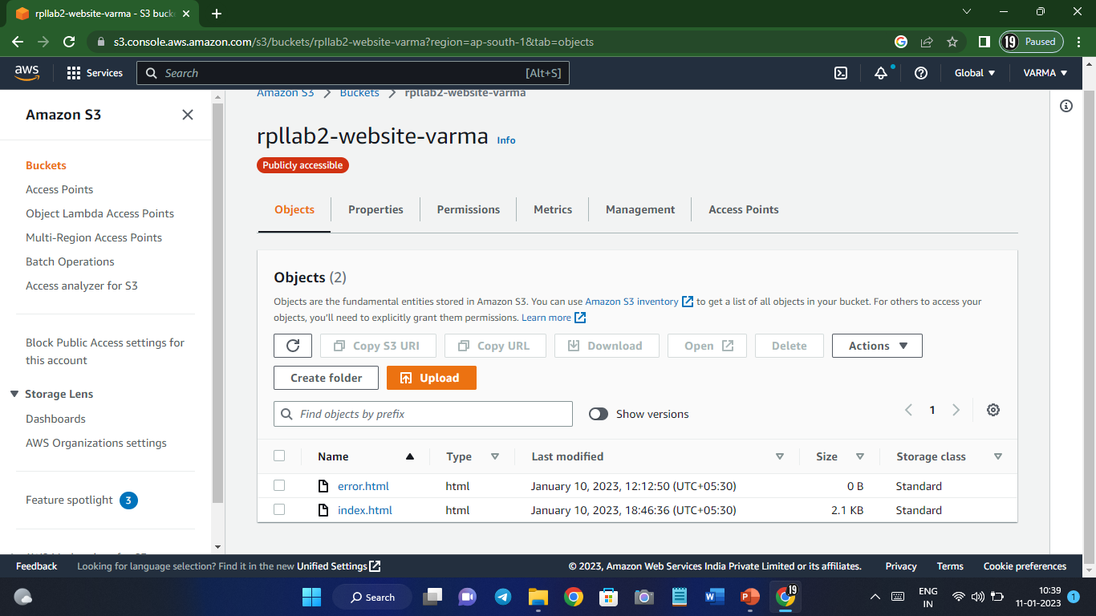
Objects in s3 Bucket

Slide 13
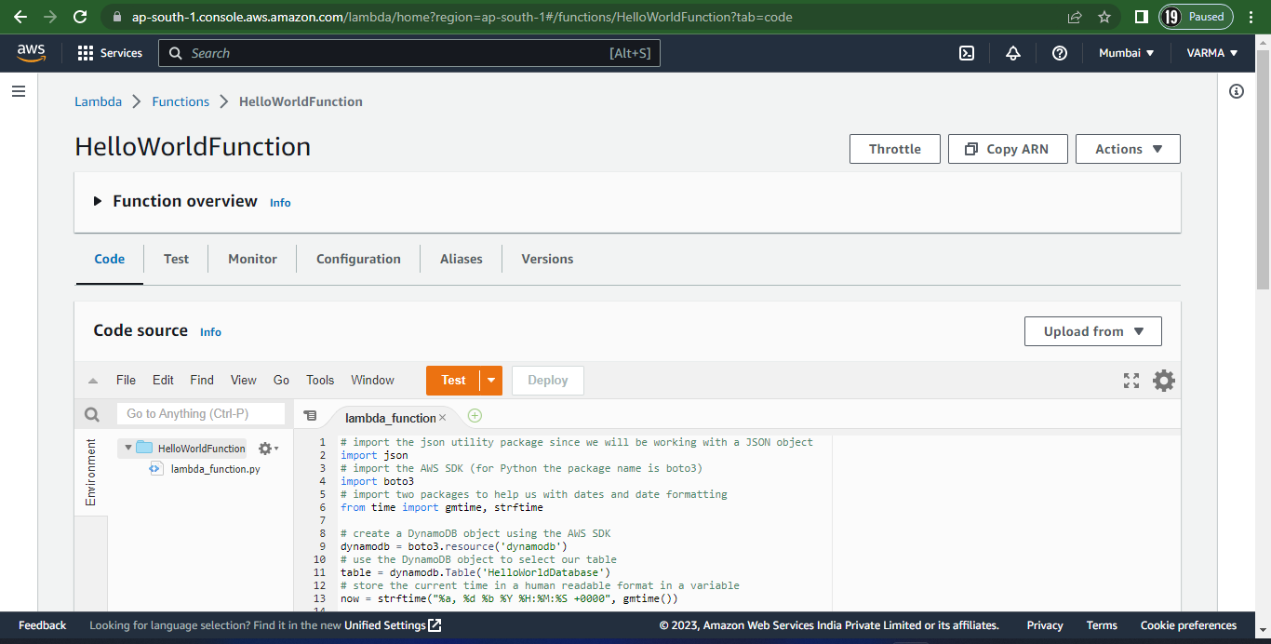
Lambda Function

Slide 14
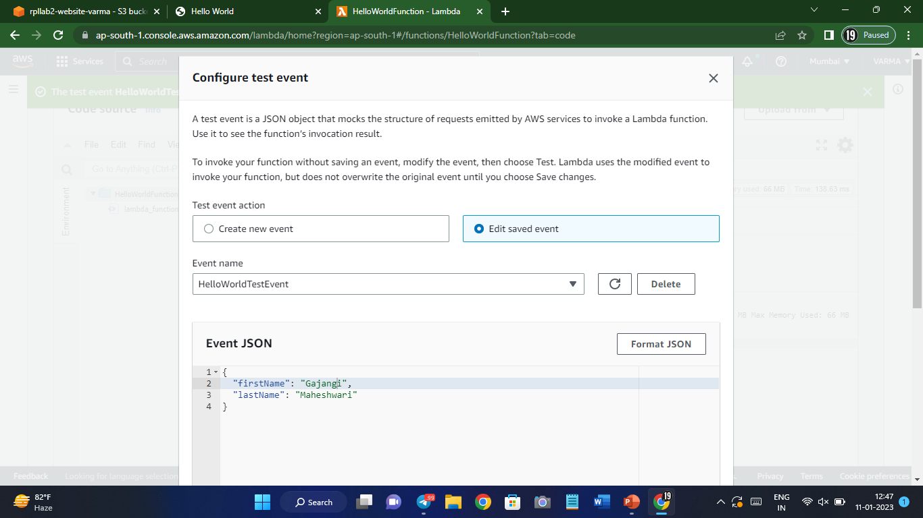

Slide 15
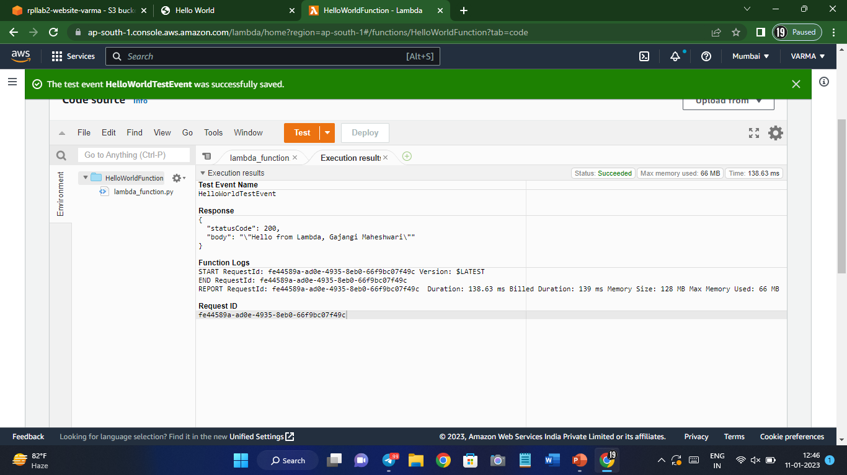

Slide 16
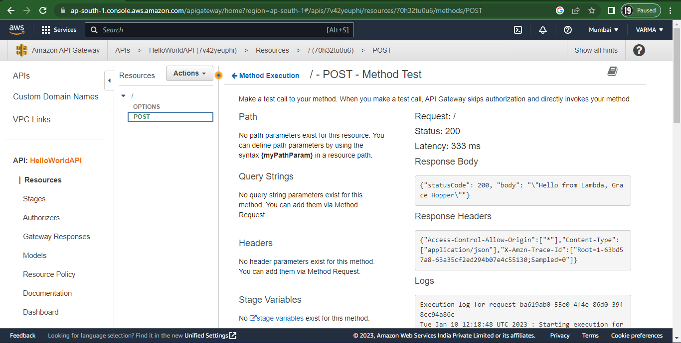
API Gateway

Slide 17
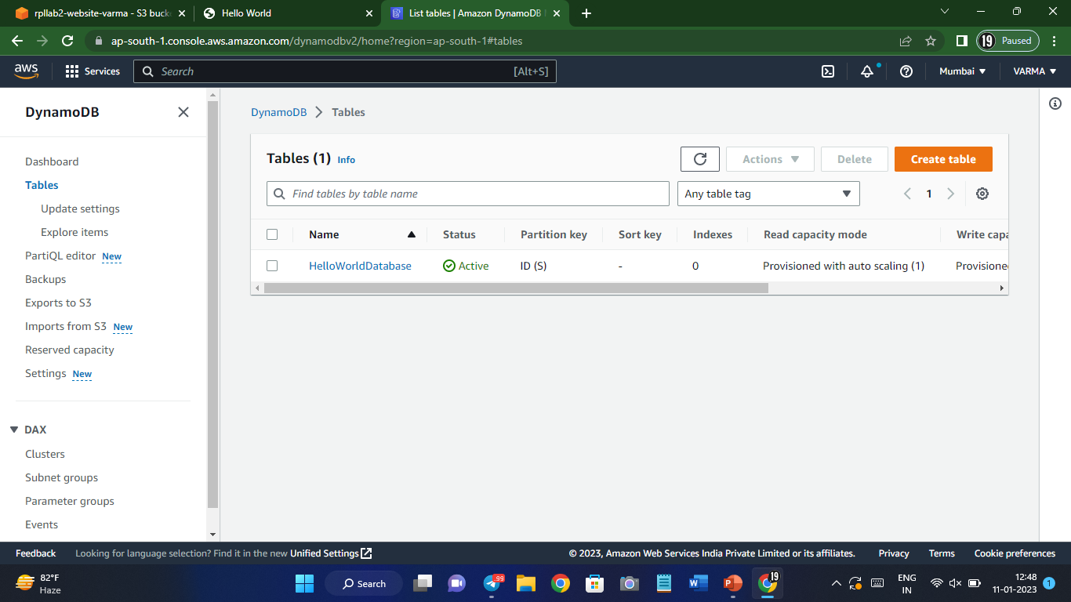
DynamoDB

Slide 18
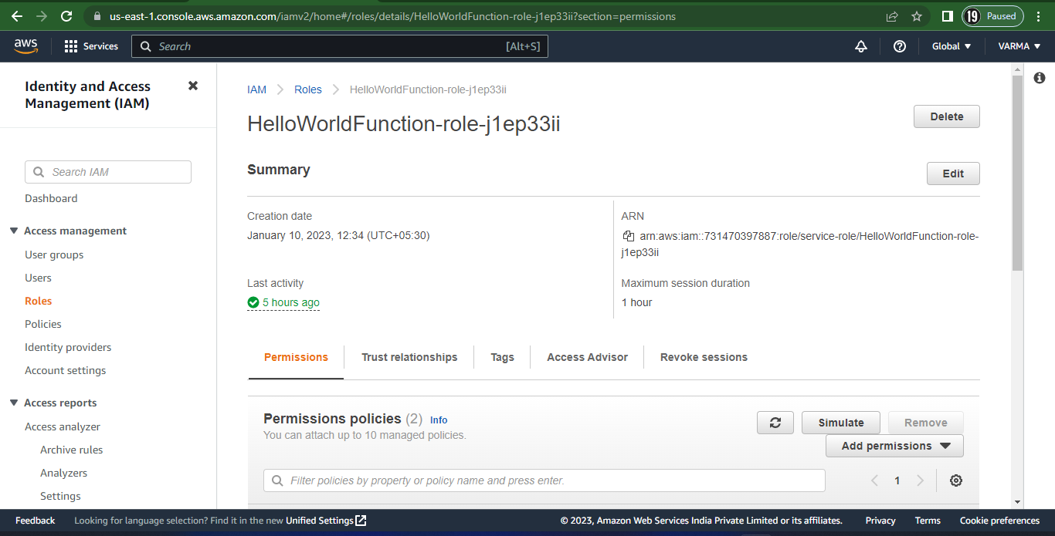
IAM

Slide 19
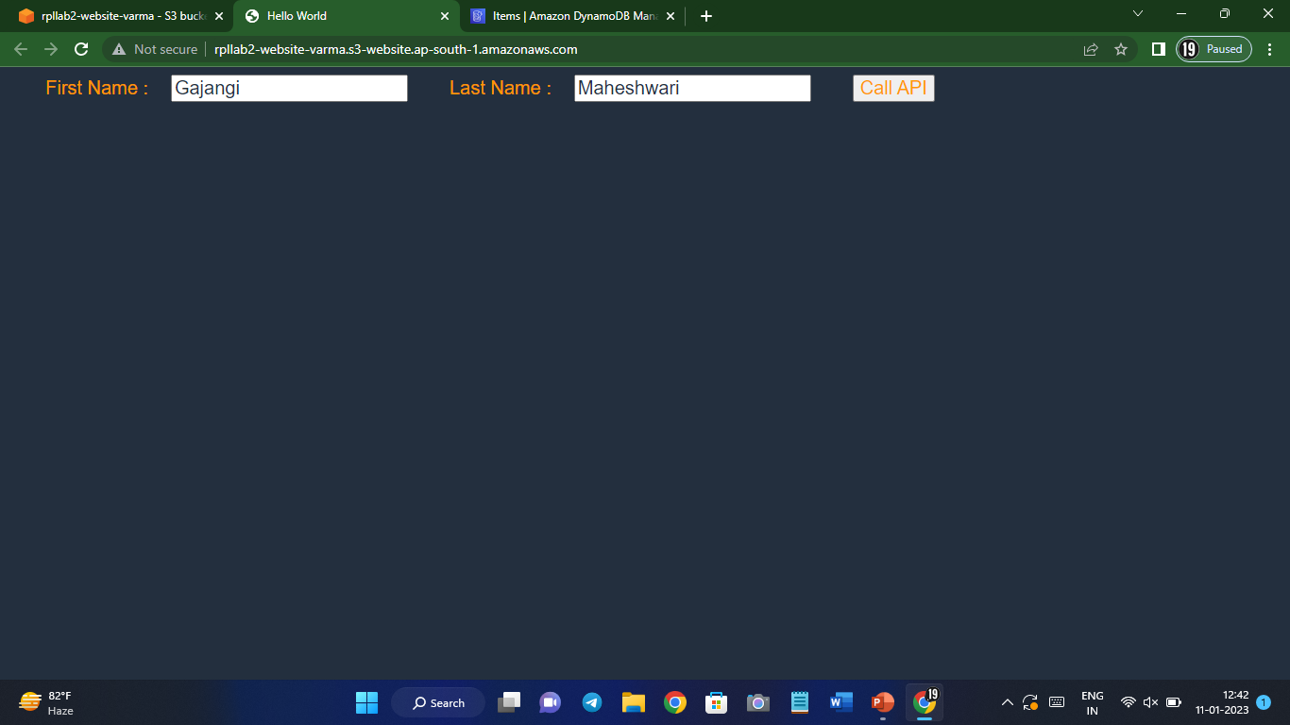
Results

Slide 20
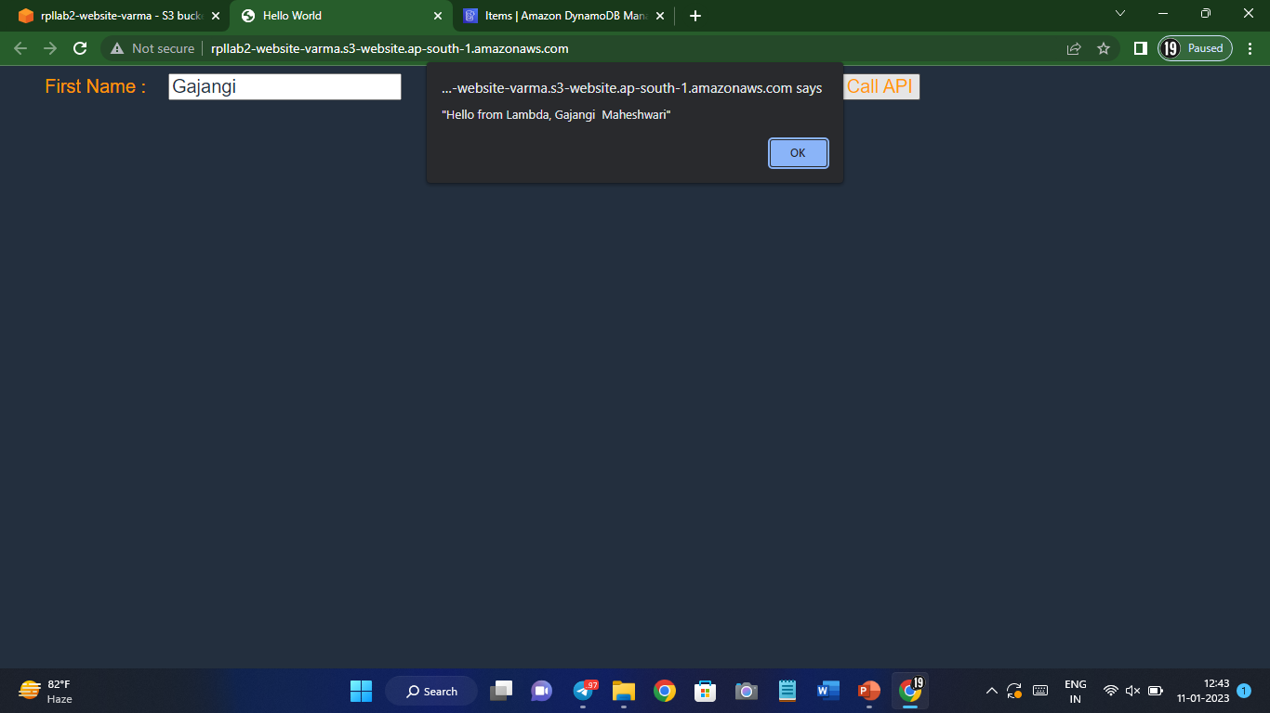
Results

Slide 21
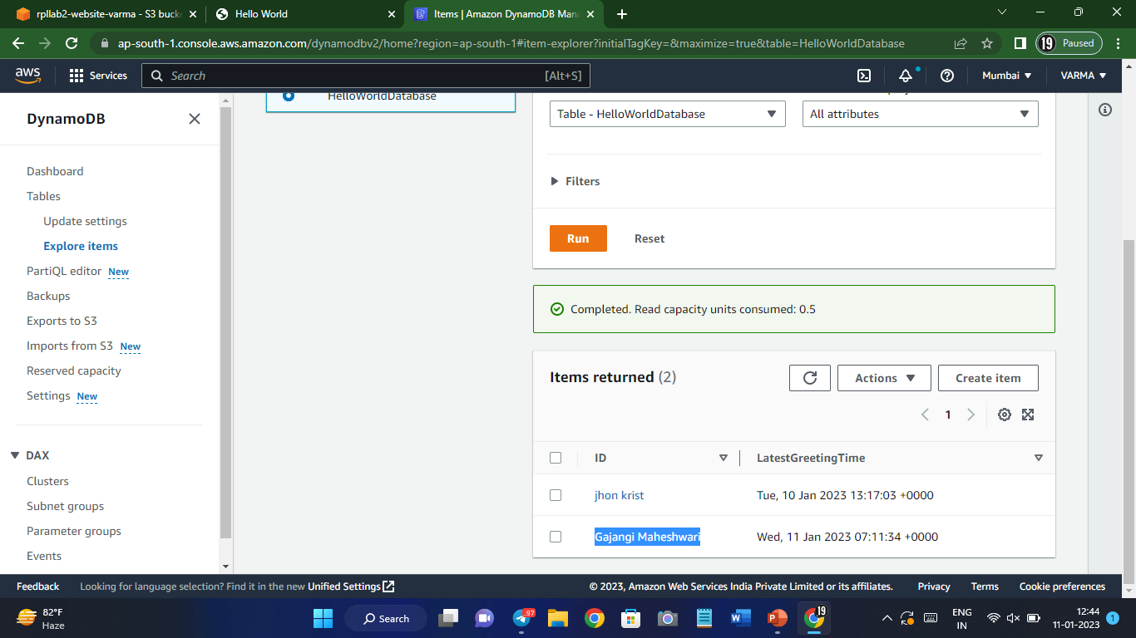
Results

Slide 22
Future scope
We can develop dynamic websites using AWS.
We can configure the same using Amplify.
We can implement a complete website such as Amazon, Flipkart etc by using different services of AWS

